Slide 1
Chap 01-05,09

Slide 2
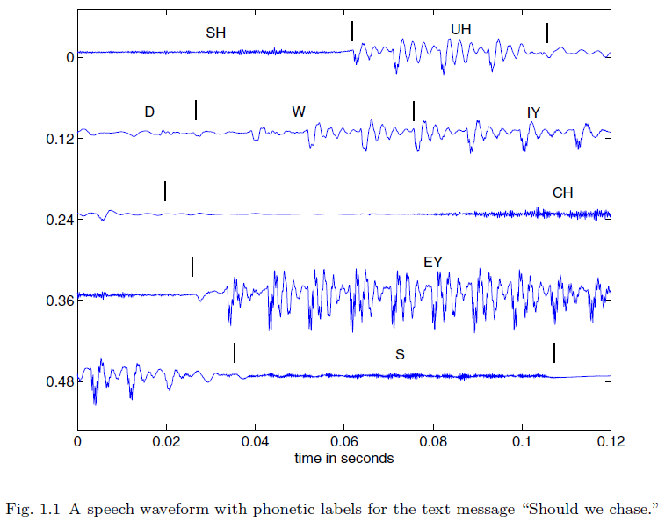
Fg1.1

Slide 3
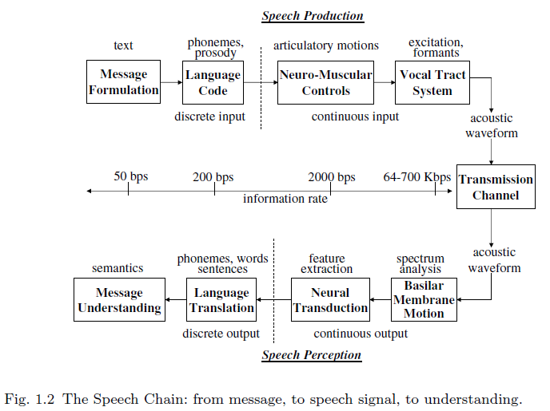
Fg1.2

Slide 4
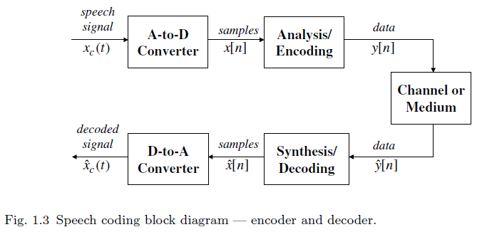
Fg1.3

Slide 5

Fg1.4

Slide 6

Fg1.5

Slide 7
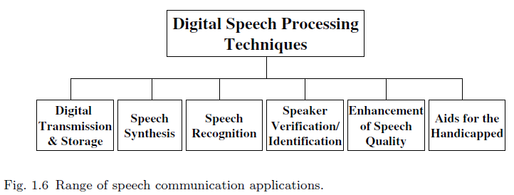
Fg1.6

Slide 8

Fg1.7

Slide 9
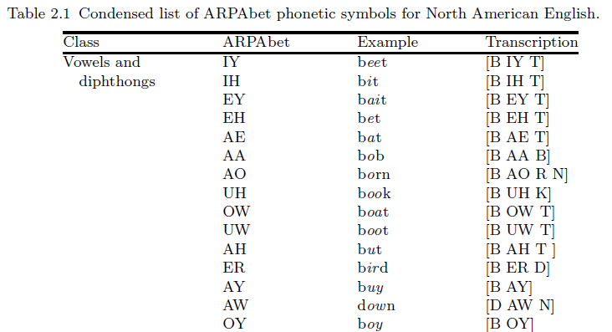
Tb2.1_1

Slide 10
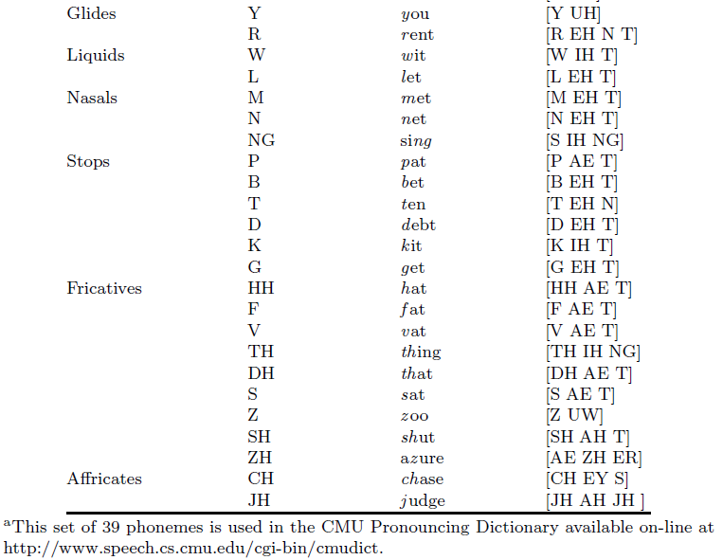
Tb2.1_2

Slide 11
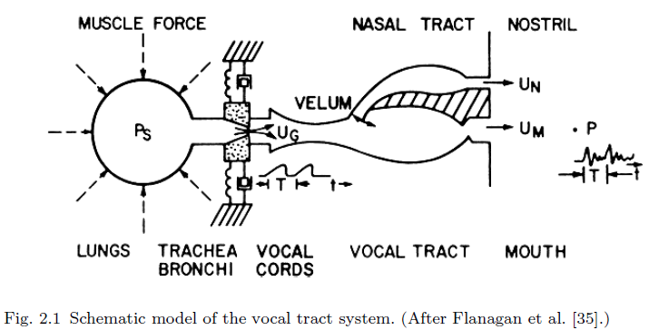
Fg2.1

Slide 12
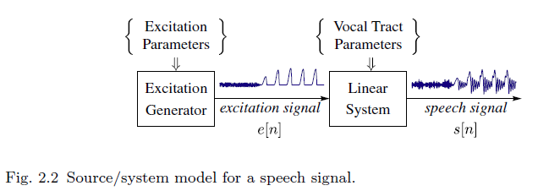
Fg2.2

Slide 13
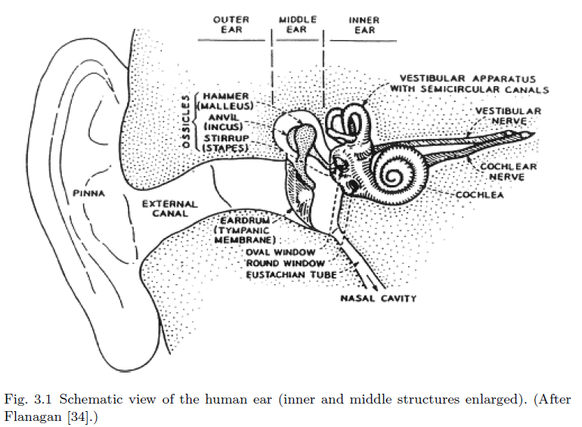
Fg3.1

Slide 14
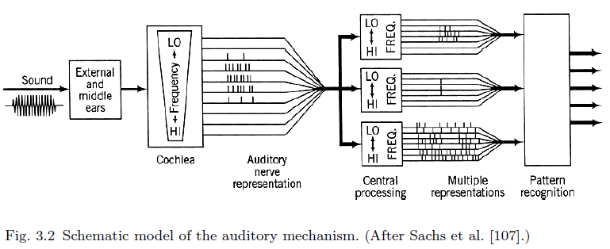
Fg3.2

Slide 15
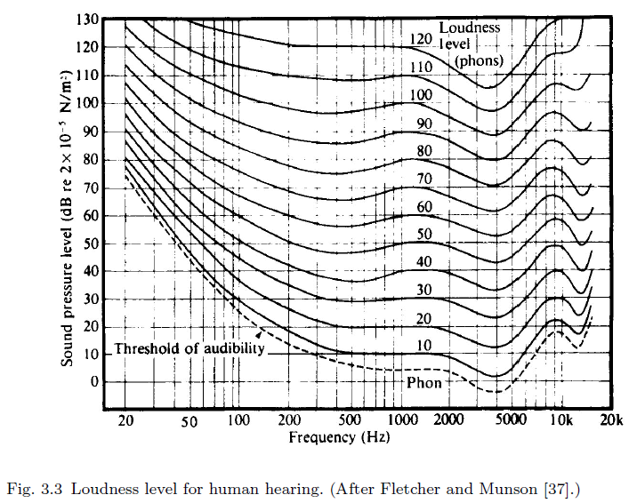
Fg3.3

Slide 16
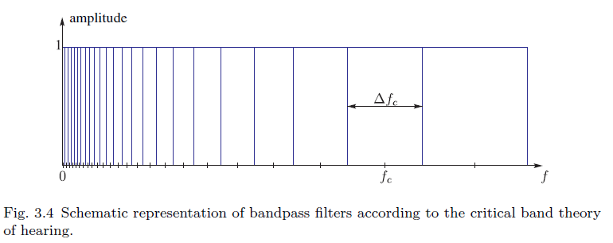
Fg3.4

Slide 17
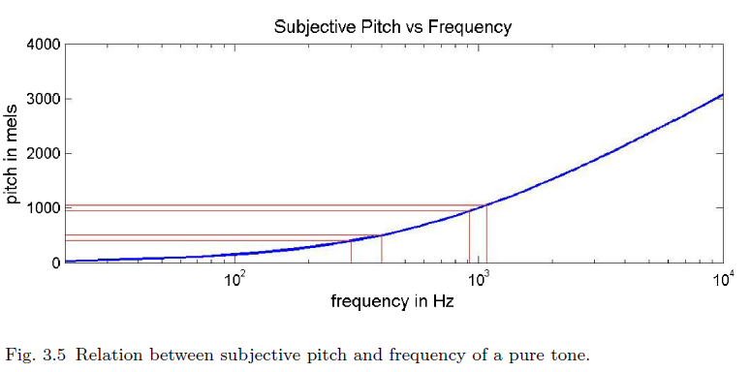
Fg3.5

Slide 18
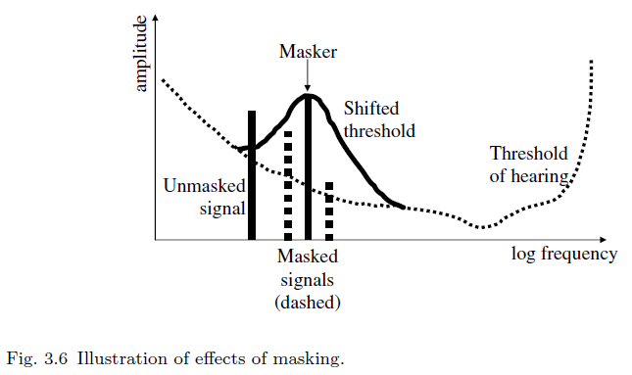
Fg3.6

Slide 19
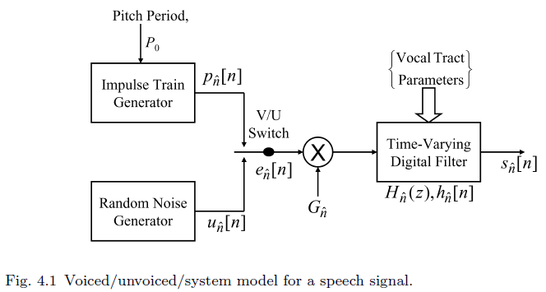
Fg4.1

Slide 20
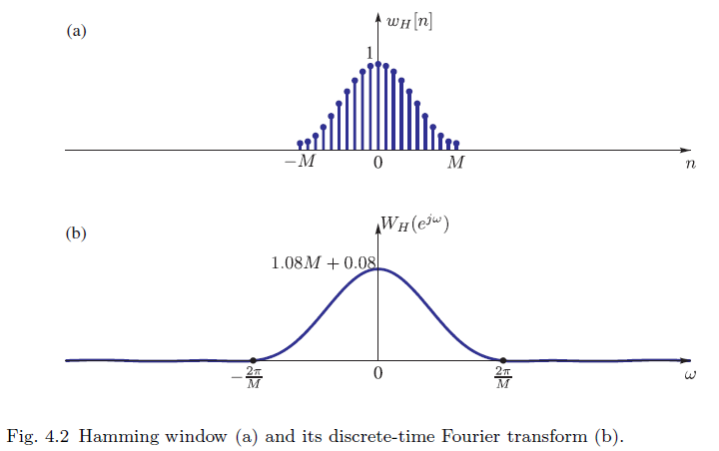
Fg4.2

Slide 21
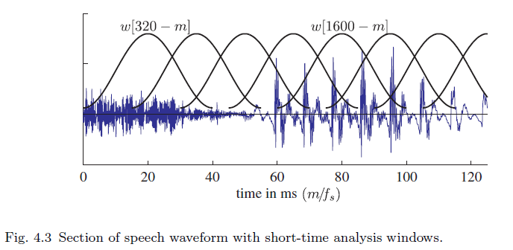
Fg4.3

Slide 22
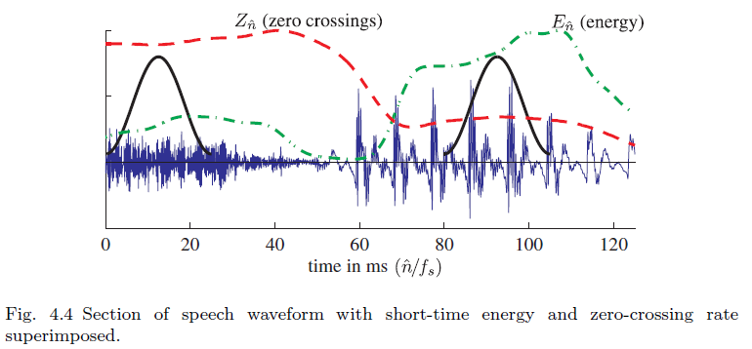
Fg4.4

Slide 23
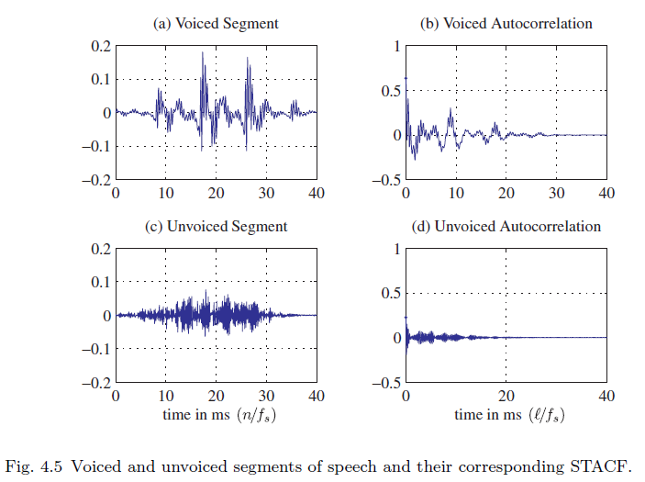
Fg4.5

Slide 24
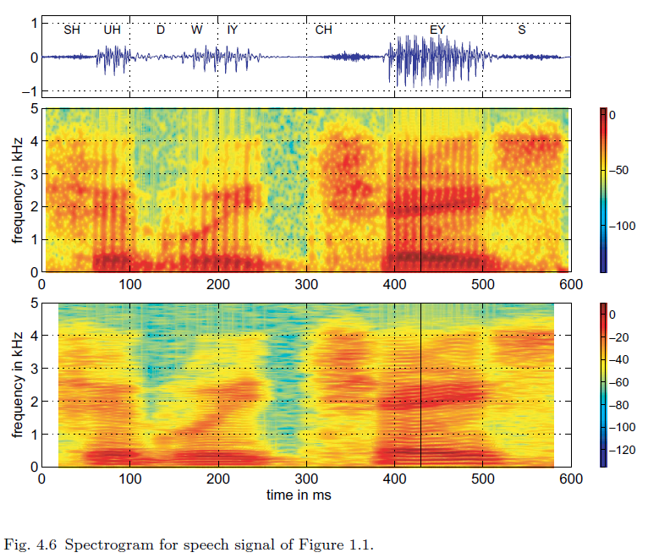
Fg4.6

Slide 25
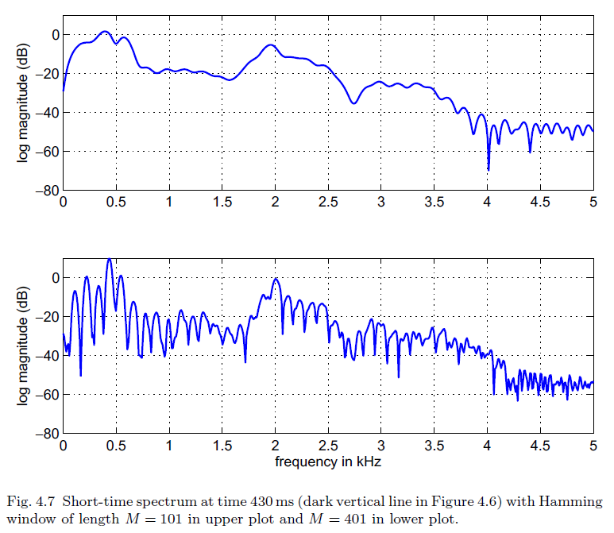
Fg4.7

Slide 26
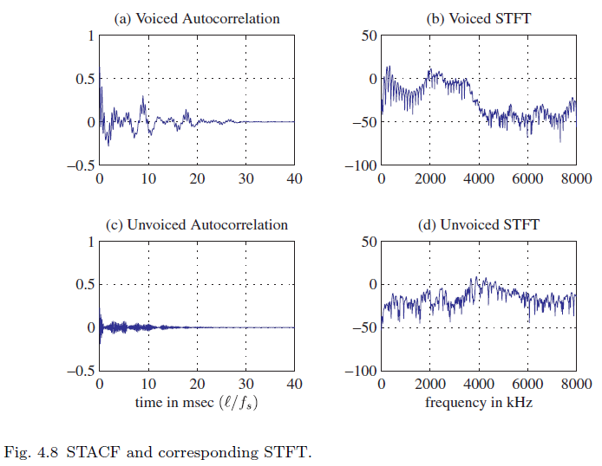
Fg4.8

Slide 27
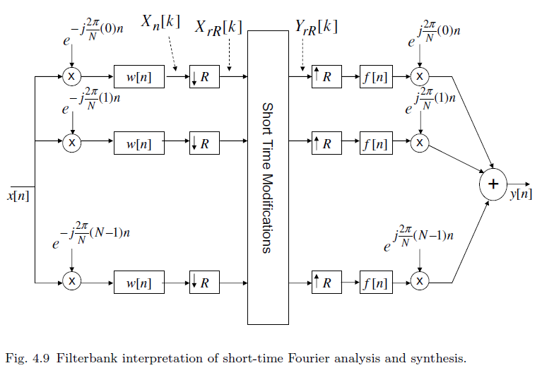
Fg4.9

Slide 28

Fg5.1

Slide 29

Fg5.2

Slide 30

Fg5.3

Slide 31

Fg5.4

Slide 32
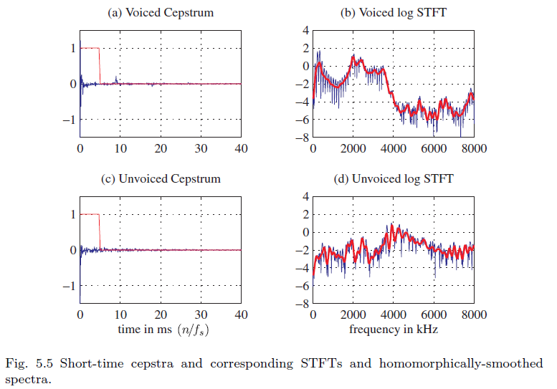
Fg5.5

Slide 33
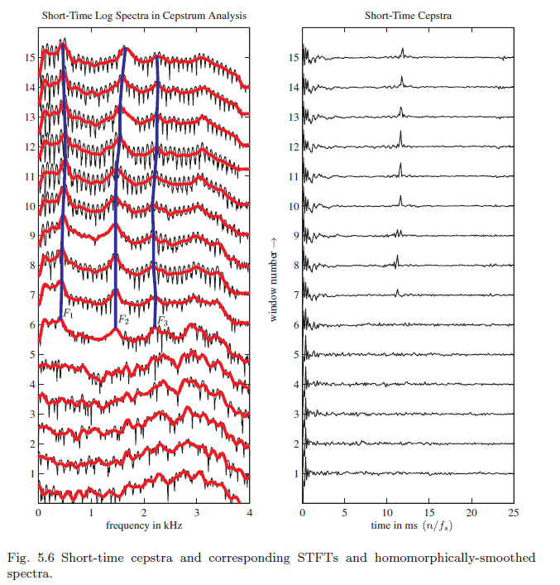
Fg5.6

Slide 34
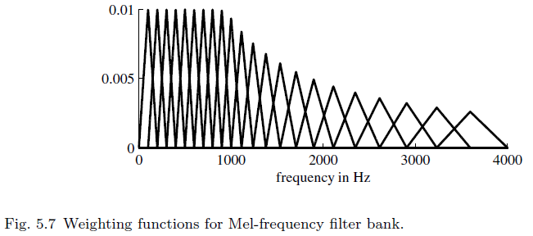
Fg5.7

Slide 35
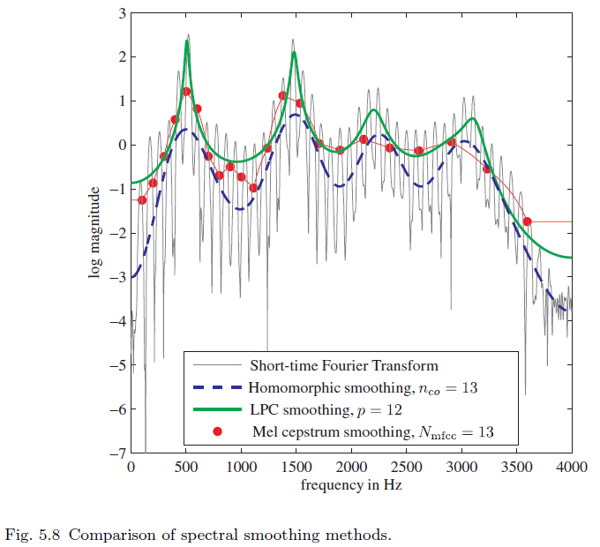
Fg5.8

Slide 36
Fg5.9

Slide 37

Fg9.1

Slide 38
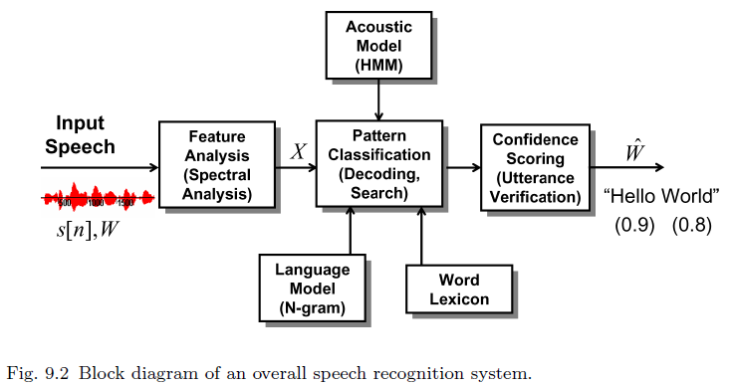
Fg9.2

Slide 39
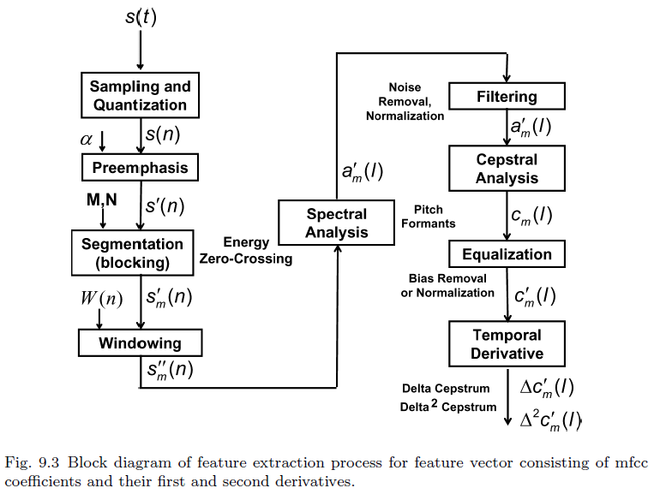
Fg9.3

Slide 40
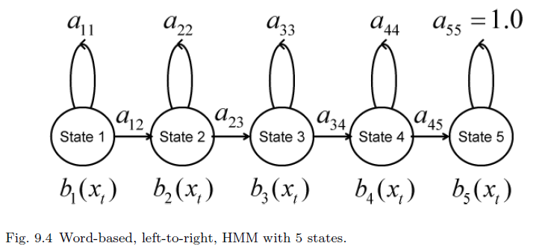
Fg9.4

Slide 41
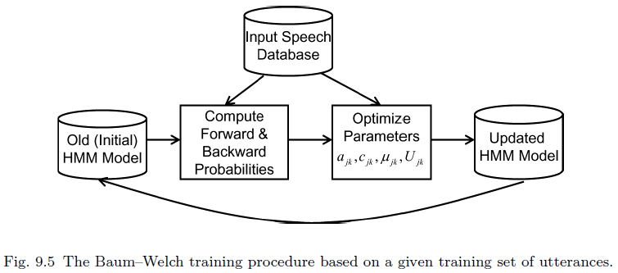
Fg9.5

Slide 42
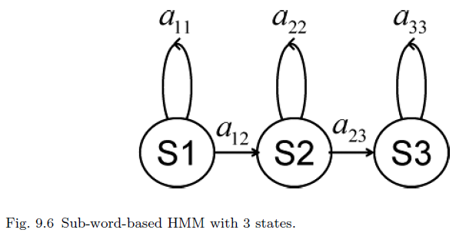
Fg9.6

Slide 43

Fg9.7

Slide 44
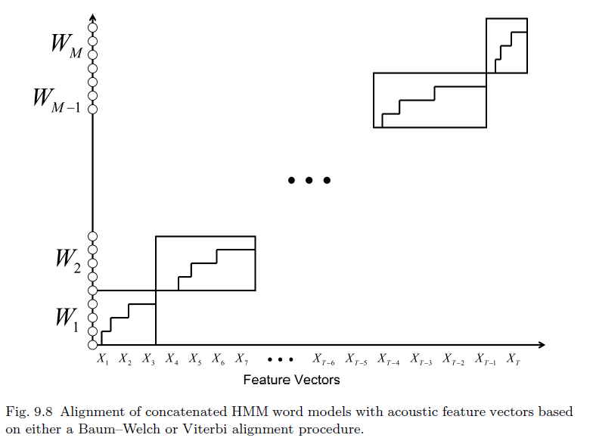
Fg9.8

Slide 45
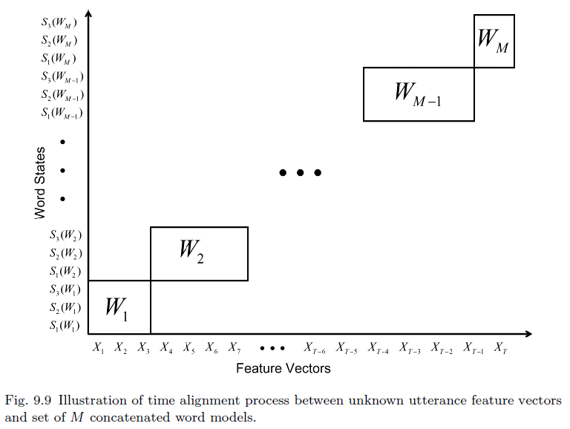
Fg9.9

Slide 46

Fg9.10

Slide 47
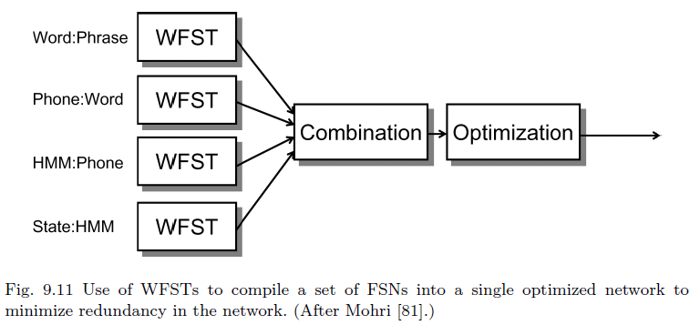
Fg9.11

Slide 48
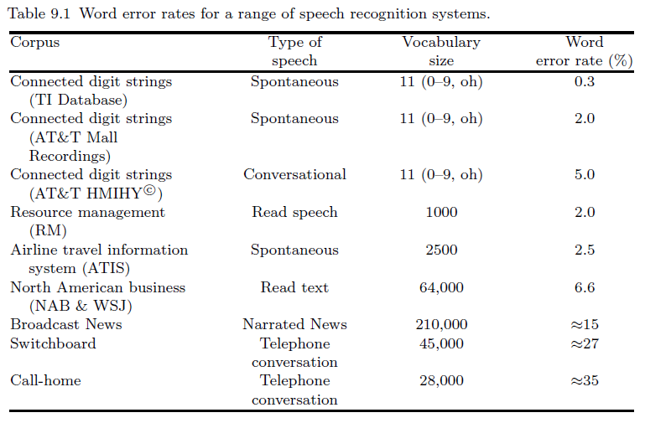
Tb9.1

Slide 50
HMM in ASR

Slide 51
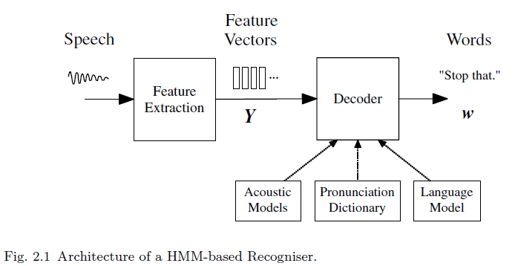
Fg2.1

Slide 52
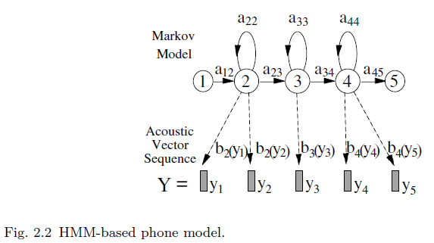
Fg2.2

Slide 53
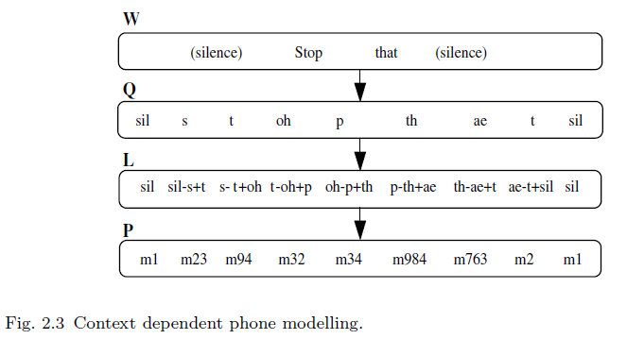
Fg2.3

Slide 54
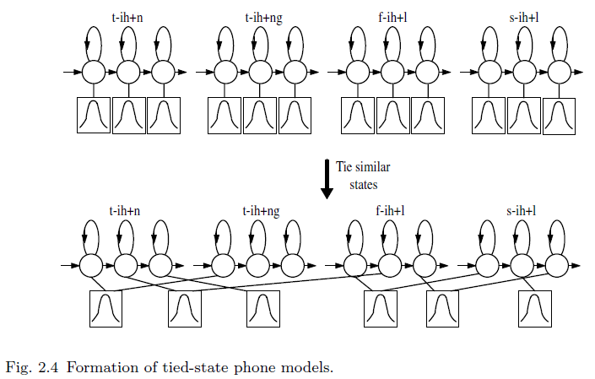
Fg2.4

Slide 55
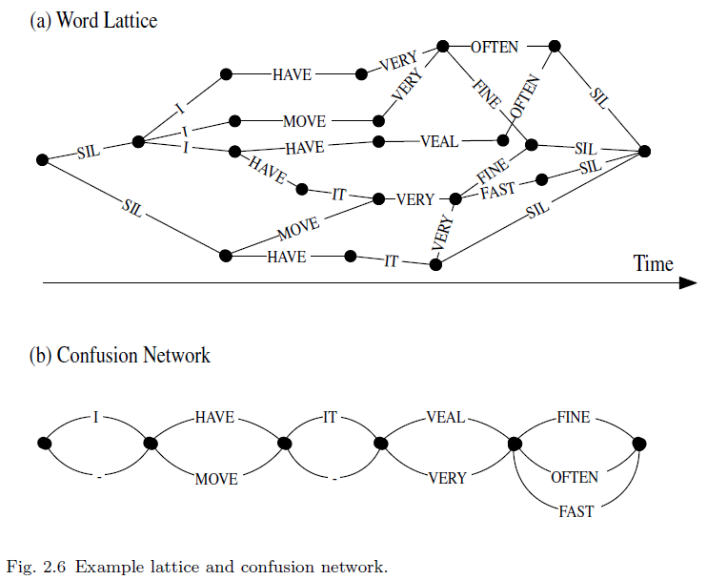
Fg2.5

